Slide 1
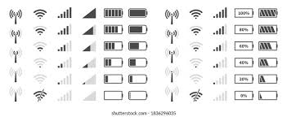
Mobile Network Signal Strength Prediction

Slide 2
Introduction
Mobile networks are the backbone of modern communication.
However, signal strength varies due to location, obstacles, tower distance, and frequency bands.
A Mobile Network Signal Strength Predictor helps estimate coverage quality using Machine Learning.
It assists users (to choose better locations/networks) and telecom companies (to optimize tower placement).

Slide 3
Problem Statements & Objectives
⚠️ Problem
📶 Uneven and weak mobile network coverage in many regions.
📱 Frequent call drops, slow internet, and poor connectivity.
🎯 Objectives
🤖 Predict signal strength using ML models.
🗂️ Preprocess & analyze real signal datasets.
📊 Improve prediction accuracy with feature engineering.
🌐 Provide insights for better connectivity planning.

Slide 4
Literature Survey Table
Year | Title | Techniques | Accuracy | Dataset | Limitations
2018 | Cellular Signal Prediction using ML | Linear Regression, Decision Trees | ~82% | LTE/4G Mobile Network Signal Strength | Limited dataset; low generalization
2020 | Mobile Signal Strength Forecasting | Random Forest, Gradient Boosting | ~90% | Wireless Signal Strength Dataset | Needs large training data; model complexity
2021 | Deep Learning for Signal Prediction | Neural Networks (ANN, CNN) | ~94% | Mobile Network Signal Strength | High computational cost; requires GPU
2023 | Hybrid ML Models for Signal Prediction | Random Forest + Neural Networks | ~96% | Cell Phone Signal Strength Data | Data imbalance between strong and weak signals

Slide 5
Tools Used
Dataset: Mobile signal strength datasets (Kaggle / real-world surveys).
Programming: Python
Environment: Jupyter Notebook / VS Code
Libraries:
  Pandas – Data Handling
  Scikit-learn – ML Models
  Matplotlib / Seaborn – Visualization
Optional Frontend: HTML / CSS Dashboard for visualization

Slide 6
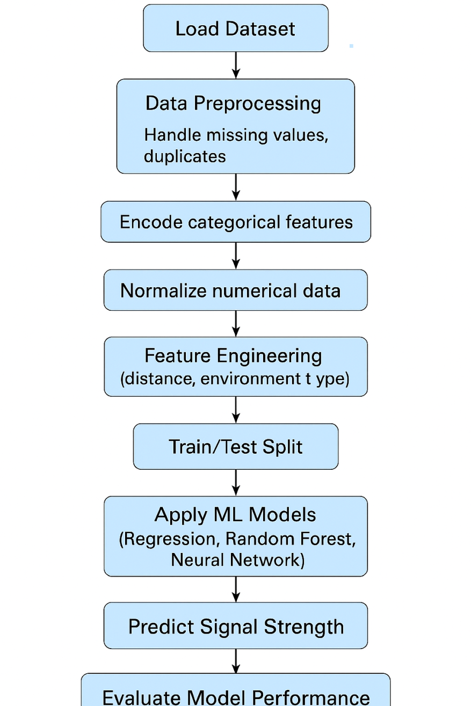
Flow Chart

Slide 7
Dataset Analysis
Dataset Size: ~X rows, 5 main columns
Features: Latitude, Longitude, Signal Strength (dBm), Throughput (Mbps), Latency (ms)
Target Variable: Signal Strength (dBm)
Data Range:
Signal Strength: –115 to –75 dBm
Throughput: varies with signal
Latency: higher when signal is weak
Key Insight:
“Signal strength is strongly related to throughput and latency, and varies by location.”

Slide 8
Preprocessing of data
Steps performed:
Load dataset.
Handle missing GPS/environment entries.
Remove duplicate records.
Convert data types (float for coordinates, int for frequencies).
Encode categorical features (Tower ID, Environment).
Normalize values for distance and frequency.

Slide 9
Code of Preprocessing
import pandas as pd
import numpy as np
from sklearn.preprocessing import StandardScaler
# 1. LOAD DATA
df = pd.read_csv("signal_metrics.csv")
# 2. DROP USELESS / LOW INFORMATION COLUMNS
drop_cols = ["Signal Quality (%)"] # contains all zeros
df = df.drop(columns=drop_cols, errors="ignore")
# 3. REMOVE OUTLIERS
# Remove unrealistic signal values
df = df[(df["Signal Strength (dBm)"] > -120) & (df["Signal Strength (dBm)"] < -40)]
# Remove large latency & throughput outliers
df = df[df["Latency (ms)"] < 500]
df = df[df["Data Throughput (Mbps)"] < 400]

Slide 10
# 6. SCALE NUMERICAL FEATURES
scaler = StandardScaler()
num_cols = [
"Latitude",
"Longitude",
"Data Throughput (Mbps)",
"Latency (ms)",
"BB60C Measurement (dBm)",
"srsRAN Measurement (dBm)",
"BladeRFxA9 Measurement (dBm)"
]
df[num_cols] = scaler.fit_transform(df[num_cols])
# 7. SAVE CLEANED DATASET
df.to_csv("cleaned_signal_data.csv", index=False)
print("✅ Preprocessing Completed Successfully!")
print("✅ Clean file saved as: cleaned_signal_data.csv")
4. HANDLE MISSING VALUES
# Fill numeric missing values with column mean
for col in df.select_dtypes(include=np.number).columns:
df[col] = df[col].fillna(df[col].mean())
# Fill categorical missing values with mode
for col in df.select_dtypes(include="object").columns:
df[col] = df[col].fillna(df[col].mode()[0])
# 5. ENCODE CATEGORICAL COLUMNS
df = pd.get_dummies(df, columns=["Network Type"])

Slide 11
THANK YOU

